Slide 1
Strings

Slide 2
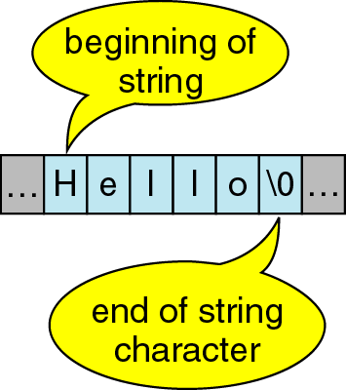
Character Strings
A sequence of characters is often referred to as a character “string”.
A string is stored in an array of type char ending with the null character '\0 '.

Slide 3
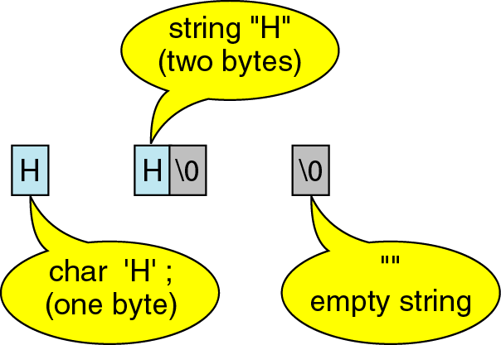
Character Strings
A string containing a single character takes up 2 bytes of storage.

Slide 4
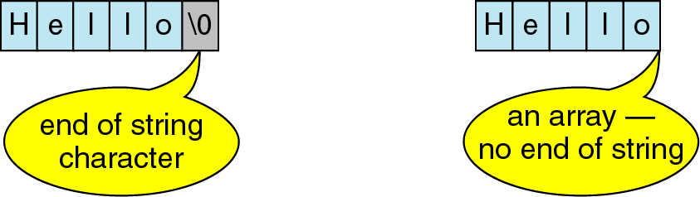
Character Strings

Slide 5
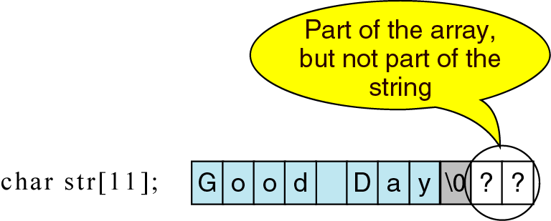
Character Strings

Slide 6
Character vs. String
A string constant is a sequence of characters enclosed in double quotes.
  For example, the character string:
  char s1[2]="a"; //Takes two bytes of storage.
  s1:
  On the other hand, the character, in single quotes:
  char s2= `a`; //Takes only one byte of storage.
  s2:
a | \0
a

Slide 7
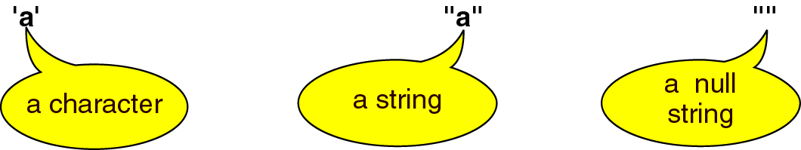
Character vs. String

Slide 8
Example 1
char message1[12] = "Hello world";
cout << message1 << endl;
message1:
char message2[12];
cin >> message2; // type "Hello" as input
message2:

Slide 9
Example 2: String I/O
String can be input using the extraction operator >>, but one or more white spaces indicates the end of an input string.
char A_string[80], E_string[80];
cout << "Enter some words in a string:\n";
cin >> A_string >> E_string;
cout << A_string << E_string
<< “\nEND OF OUTPUT\n";
Output:
Enter some words in a string:
This is a test.
Thisis
END OF OUTPUT

Slide 10
getline
The function getline can be used to read an entire line of input into a string variable.
The getline function has three parameters:
  The first specifies the area into which the string is to be read.
  The second specifies the maximum number of characters, including the string delimiter.
  The third specifies an optional terminating character. If not included, getline stops at ‘\n’.

Slide 11
Example 3: getline
char A_string[80];
cout << "Enter some words in a string:\n";
//80 is the size of A_string
cin.getline(A_string, 80);
cout << A_string << “\nEND OF OUTPUT\n";
Output:
Enter some words in a string:
This is a test.
This is a test.
END OF OUTPUT

Slide 12
Example 4: getline Example
char A_string[5], E_string[80];
cout << "Enter some words in a string:\n";
cin >> A_string;
cin.getline (E_string, 9) ;
cout << A_string << "#" << E_string
<< “\nEND OF OUTPUT\n";
Output:
Enter some words in a string:
This is a test.
This# is a te
END OF OUTPUT

Slide 13
Example 5: getline Example
char lastName[30], firstName[30];
cout << "Enter a name <last,first>:\n";
cin.getline (lastName, sizeof(lastName), ',');
cin.getline (firstName, sizeof(firstName));
cout << "Here is the name you typed:\n\t|"
<< firstName << " " << lastName << "|\n";
Output:
Enter a name in the form <last,first>:
Chan,Anson
Here is the name you typed:
|Anson Chan|

Slide 14
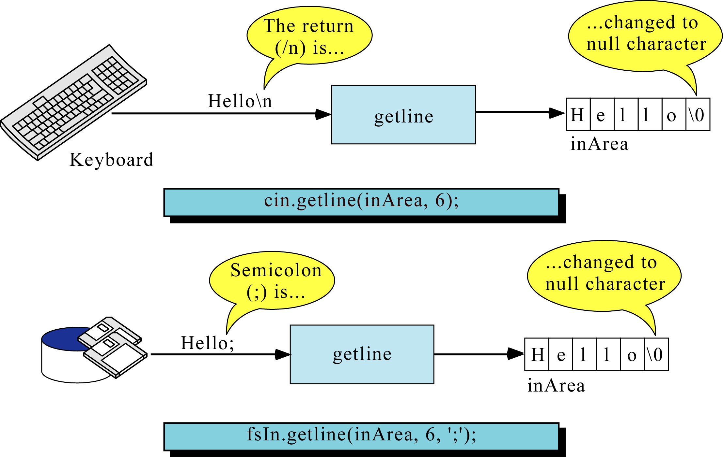

Slide 15
Ex. 6: String Copy Function in <cstring>
void strcpy(char dest[], const char src[]); //copies string src into string dest
example:
char name1[16], name2[16];
strcpy(name1,“BASHIR AHMED");
name1:
name2:
name2:
B | A | S | H | I | R |  | A | H | M | E | D | \0 | ? | ? | ?
strcpy(name2,"999999999999999");
9 | 9 | 9 | 9 | 9 | 9 | 9 | 9 | 9 | 9 | 9 | 9 | 9 | 9 | 9 | \0
strcpy(name2,name1);
B | A | S | H | I | R |  | A | H | M | E | D | \0 | 9 | 9 | \0

Slide 16
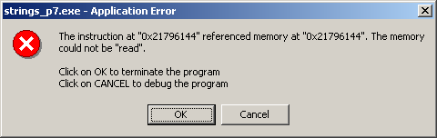
Example 7: strcpy in <cstring>
#include <iostream.h>
#include <cstring.h>
int main (){
char string_1[6] = "Short"; // character strings
char string_2[17] = "Have a Nice Day";
char string_3[6] = "Other";
strcpy(string_1, string_2);
return 0;
}

Slide 17
Ex. 8: String Length Check Function in <cstring>
// string prototype, already included in string.h
//returns length of string(not counting'\0‘)
//you don't need to include it in your program
int strlen(const char[]);
int string_length = strlen("abcde");
//string_length is set to 5.

Slide 18
Ex. 9: String Length Check Function Example
#include <iostream.h>
#include <cstring.h>
int main(){
char string_1[5] = "ABCD", string_2[10]="123456789";
cout << "String 1 = " << string_1 << endl;
cout << "String 2 = " << string_2 << endl;
strncpy(string_1,string_2,strlen(string_1));
cout << "After copying, string 1 = " << string_1<<endl;
return 0;
}
//output:
String 1 = ABCD
String 2 = 123456789
After copying, string 1 = 1234

Slide 19
Ex. 10: String Length Check Function in <cstring>
//Copy the value of a string to a string variable
#include <iostream.h>
#include <string.h>
void string_copy(char target[], const char source[],
int target_size);
//Before: target_size is the declared size of target. //not including '\0'.
//After: The value of target has been set to the string
//value in source, provided the declared size of
//target is large enough. If target is not large
//enough to hold the entire string, a string
//equal to the length of target will be stored.

Slide 20
Ex. 10: String Copy and String Length Check
int main( ) //Driver function
{
char short_string[11];
char long_string[] = "This is rather long.";
cout << long_string << "STRING ENDS HERE.\n";
string_copy(short_string, "Hello", 10);
cout << short_string << "STRING ENDS HERE.\n";
string_copy(short_string, long_string, 10);
cout << short_string << "STRING ENDS HERE.\n";
return 0;
}

Slide 21
Ex. 10: String Copy and String Length Check
//Uses string.h:
void string_copy(char target[], const char source[],
int target_size)
{ int index;
int new_length = strlen(source);
if (new_length > (target_size))
new_length = target_size ;
for (index = 0; index < new_length; index++)
target[index] = source[index];
target[index] = '\0';
}

Slide 22
Ex. 10: String Copy and String Length Check
Output:
This is rather long.STRING ENDS HERE.
HelloSTRING ENDS HERE.
This is raSTRING ENDS HERE.

Slide 23
String Comparison
int strcmp(char s1[], char s2[]);
/*compares strings s1 and s2, returns
    < 0 if s1 < s2
    = 0 if s1 == s2 (i.e. strcmp returns false)
    > 0 if s1 > s2
*/
int strncmp(char s1[], char s2[], int limit);
/* Same as strcmp except that at most limit characters are compared. */

Slide 24
String Comparison
int comp102_strncmp(char s1[], char s2[],
int limit)
{
for (int i=0; i < limit; i++){
if (s1[i] < s2[i])
return -1;
if (s1[i] > s2[i])
return 1;
}
return 0;
}

Slide 25
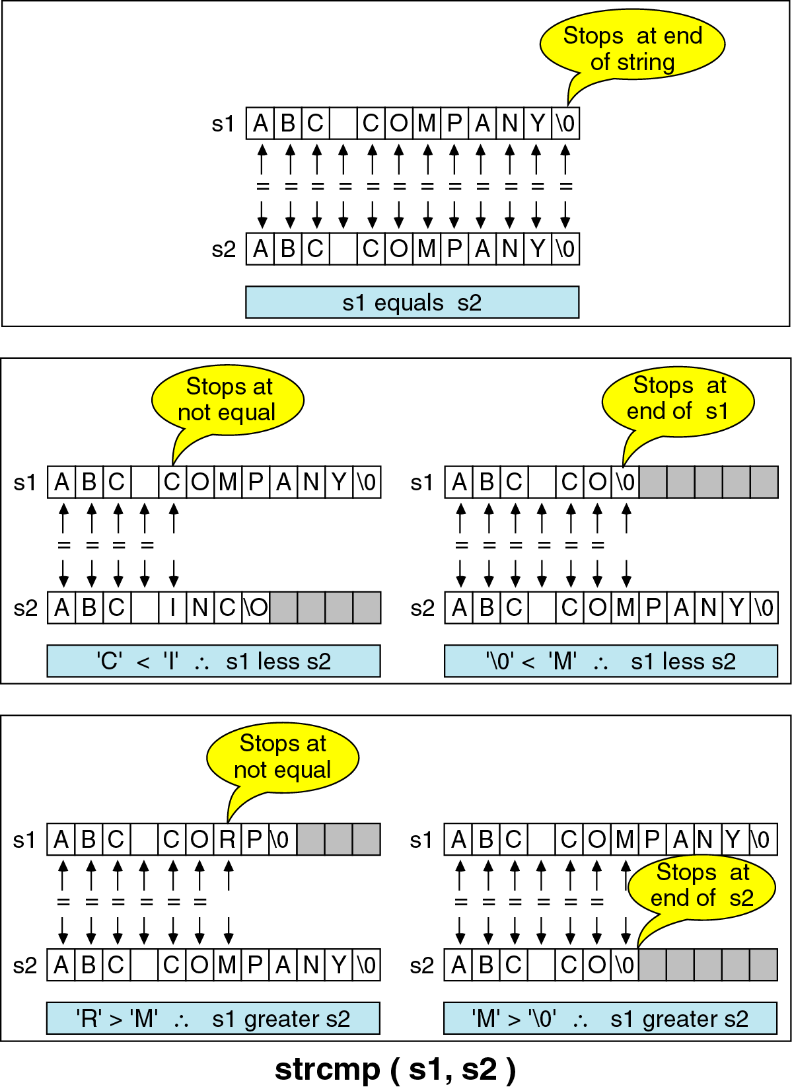

Slide 26
Ex. 11: String Comparison Examples
str1 | str2 | return value | reason
“AAAA” | “ABCD” | <0 | ‘A’ <‘B’
“B123” | “A089” | >0 | ‘B’ > ‘A’
“127” | “409” | <0 | ‘1’ < ‘4’
“abc888” | “abc888” | =0 | equal string
“abc” | “abcde” | <0 | str1 is a sub string of str2
“3” | “12345” | >0 | ‘3’ > ‘1’

Slide 27
Some Common Errors
It is illegal to assign a value to a string variable (except at declaration).
  char A_string[10];
  A_string = "Hello";
  // illegal assignment
Should use instead
strcpy (A_string, "Hello");

Slide 28
Ex. 12: Some Common Errors
The operator == doesn't test two strings for equality.
  if (string1 == string2) //wrong
  cout << "Yes!";
  // illegal comparison
  Should use instead
  if (!strcmp(string1,string2))
  cout << "Yes they are same!";
  //note that strcmp returns 0 (false) if //the two strings are the same.

